Slide 1
System Strength Overview
Aryan Ritwajeet Jha
Intern (Summer 2024)
Advanced System Analytics & Modelling (ASAM)
NERC

Slide 2
$2.3$ System Strength [AEMO-SS-Explained]
AEMC: “System strength is a characteristic of an electrical power system that relates to the size of the change in voltage following a fault or disturbance on the power system.”
System strength is expressed in the NER by reference to fault levels while inertia to rates of change in frequency (RoCoF). They are related because inertia is critical for the power system’s resilience to changes in active power.
In spite of these similarities, their remediation is different. For example, if synchronous condensers are used to address a fault level shortfall (inject current by manipulating Q), they will provide enough fault level, but will not address an inertia shortfall (not manipulating P) unless they are coupled with a rotating mass or flywheel.

Slide 3
$2.3$ System Strength [AEMO-SS-Explained]
AEMO sees system strength as the ability of the power system to maintain and control the voltage waveform at any given location in the power system, both during steady state operation and following a disturbance.
The system strength at a given location is proportional to the fault level at that location, inversely proportional to effective grid-following IBR penetration seen at that location
(where close by grid-following IBR reduces system strength more so than electrically distant IBR).
System strength is also a function of the severity of system events on the stability of IBR
(for example, loss of a major transmission line connecting the aforementioned location to the broader power system, resulting in sudden changes in fault level and voltage angle at that location).

Slide 4
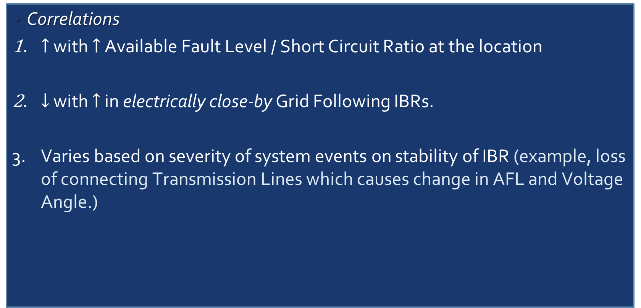
$2.3$ System Strength [AEMO-SS-Explained]
Correlations
$↑$ with $↑$ Available Fault Level / Short Circuit Ratio at the location
$↓$ with $↑$ in electrically close-by Grid Following IBRs.
Varies based on severity of system events on stability of IBR (example, loss of connecting Transmission Lines which causes change in AFL and Voltage Angle.)

Slide 5
$2.3$ System Strength [AEMO-SS-Explained]
Symptoms
Wider P, V oscillations
Prolonged V recovery
Higher Transients (deeper dips, overshoots) in V
Larger step changes in V after switching capacitor/reactor banks
Increased Harmonic Distortion (by-product of low SS and higher system impedances)
Generator fault ride-through degradation (?)

Slide 6
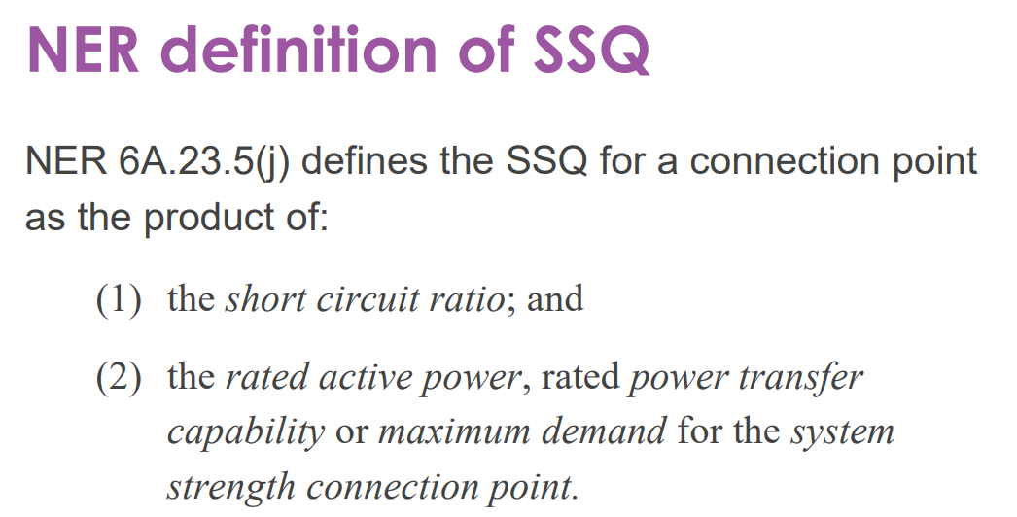
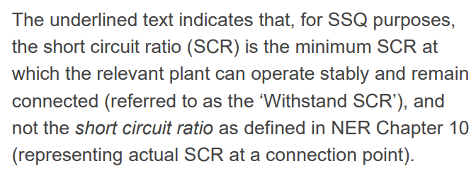
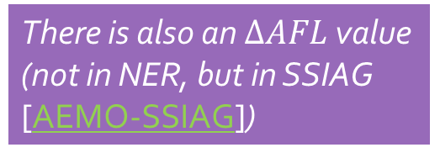
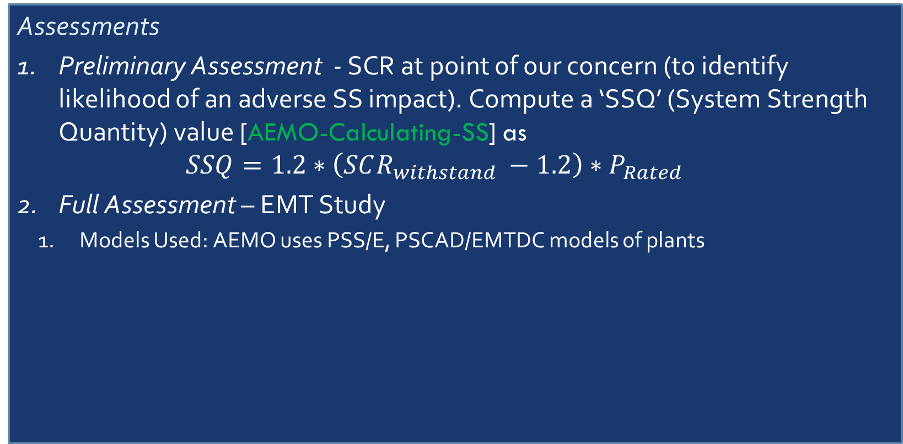
$2.3$ System Strength [AEMO-SS-Explained]
There is also an $ΔAFL$ value (not in NER, but in SSIAG [AEMO-SSIAG])
Assessments
Preliminary Assessment - SCR at point of our concern (to identify likelihood of an adverse SS impact). Compute a ‘SSQ’ (System Strength Quantity) value [AEMO-Calculating-SS] as $SSQ=1.2∗\left(SCR_{withstand} −1.2\right)∗P_{Rated}$
Full Assessment – EMT Study
Models Used: AEMO uses PSS/E, PSCAD/EMTDC models of plants
National Electricity Rules
Hmmm, then how is SCR computed again?

Slide 7
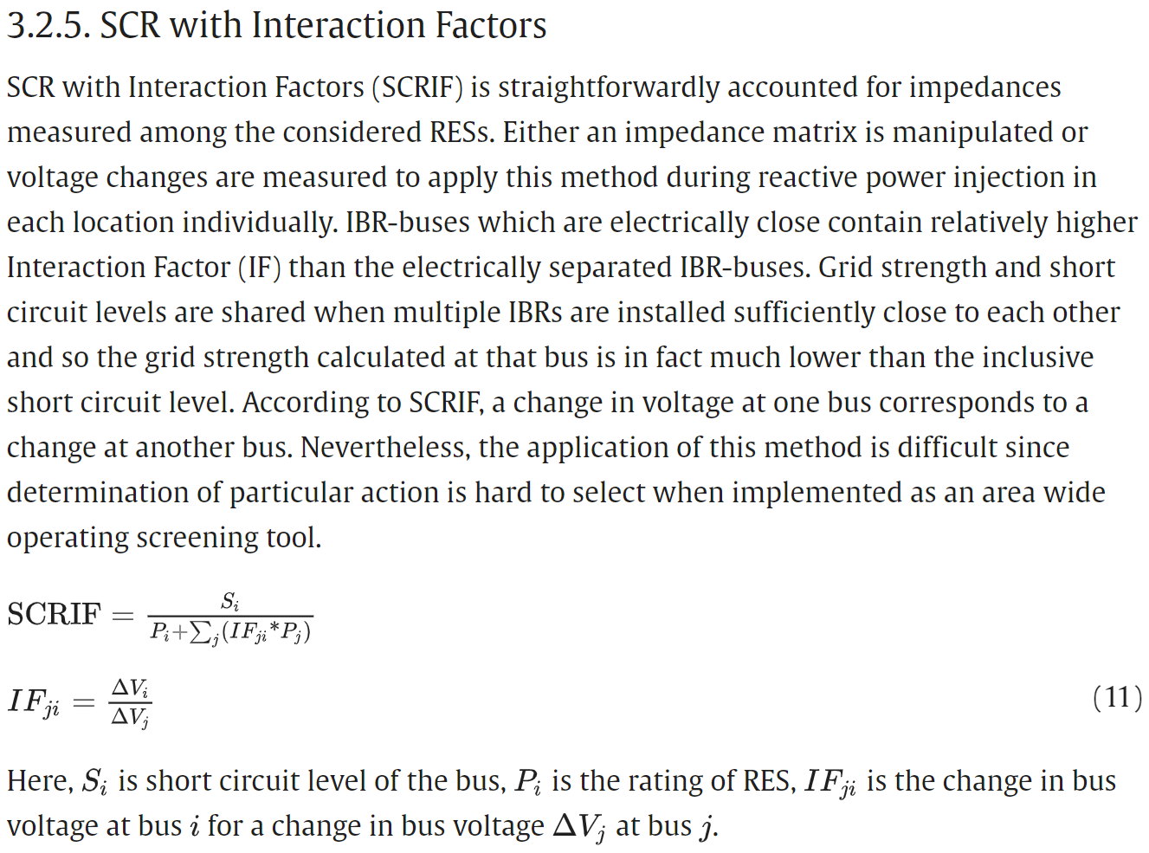
$2.3$ System Strength [AEMO-SS-Explained]
There is also an $ΔAFL$ value (not in NER, but in SSIAG [AEMO-SSIAG])
Assessments
Preliminary Assessment - Interaction Factors (incorporated into the metric Short Circuit Ratio with Interaction Factors or simply SCRIF) may be accounted for depending on how many IBRs are in proximity? [Quays2023]
There are like two other (quasi steady state) metrics which I haven’t posted here.

Slide 8
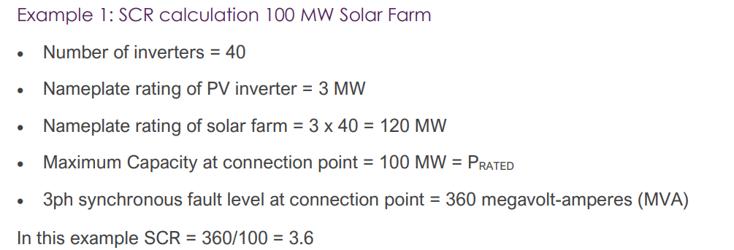
AEMO Docs for TNSPs/OEMs, etc. [AEMO-SS-FAQ]

Slide 9
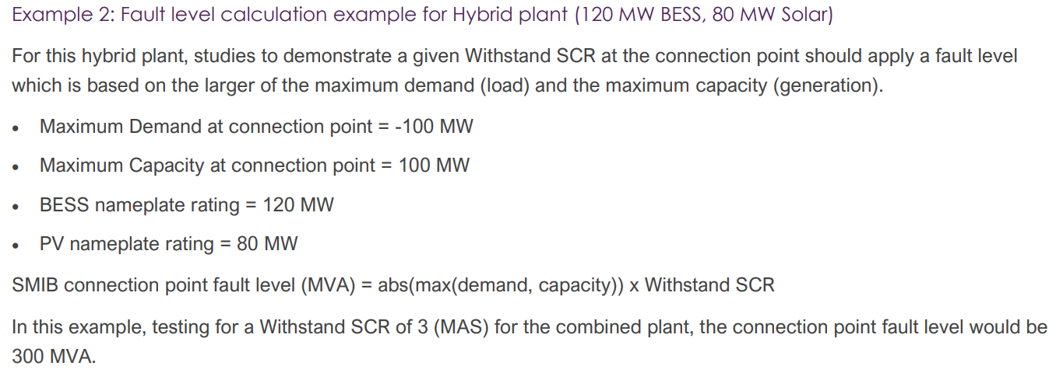
AEMO Docs for TNSPs/OEMs, etc. [AEMO-SS-FAQ]

Slide 10
$2.3$ System Strength [AEMO-SS-Explained]
Remedial Response (‘Do No Harm’ Policy)
I haven’t (yet) found any technical guidelines on how to plan/implement a remedial response. The reference talks about the motivation (why) but not any lower level details of the implementation (how). But it is only a starter reference.

Slide 11
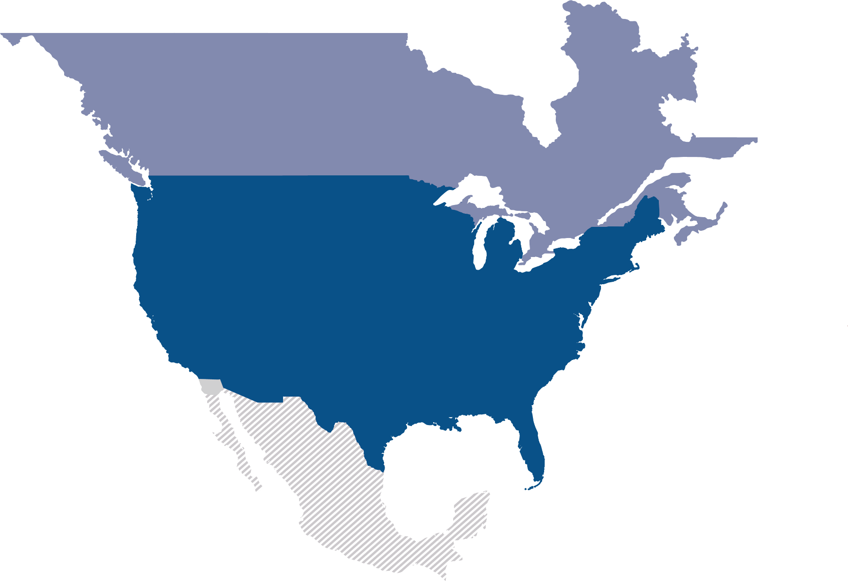
Latest Slides End. Previous Slides Follow.

Slide 12
Objective
With the greatly expanded share of renewable in power generation, IBRs along with other components and new control schemes are being used in the modern power grid at an unprecedented scale.
Issues at various scales are being observed, which may be at least partially associated with the current implementation of IBRs [odessa22, southtexas24]
We know the symptoms, but we don’t know a systematic diagnosis. So, people have come up with the concept System Strength which will help investigate and fix these symptoms (ideally before they ever even occur).

Slide 13
Objective
Starter questions:
How to measure system strength (SS) of a system?
What are the various kinds of issues observed when SS is low?
How to model SS with increasing complexity due to increasing number of generators in the grid?
How to provide SS through generators and inverters using new technologies?

Slide 14
System Strength – Preliminary Definition
System Strength – AEMO understands it as the Ability of a system to maintain its Voltage (waveform and phase angle) [AEMO-SS-Brief]
How exactly (mathematically)? – A concrete metric not seen by me yet. AEMO’s guidelines have been banking on Available Fault Level (AFL).
Voltage where exactly? – Not Mathematically specified. All documents I’ve read seem to focus more on some local voltage as opposed to a particular voltage (PoI, node voltage, bus voltage, etc.)
Current ‘metric’ is basically a holistic combination of Available Fault Level and IBR Stability Criteria.

Slide 15
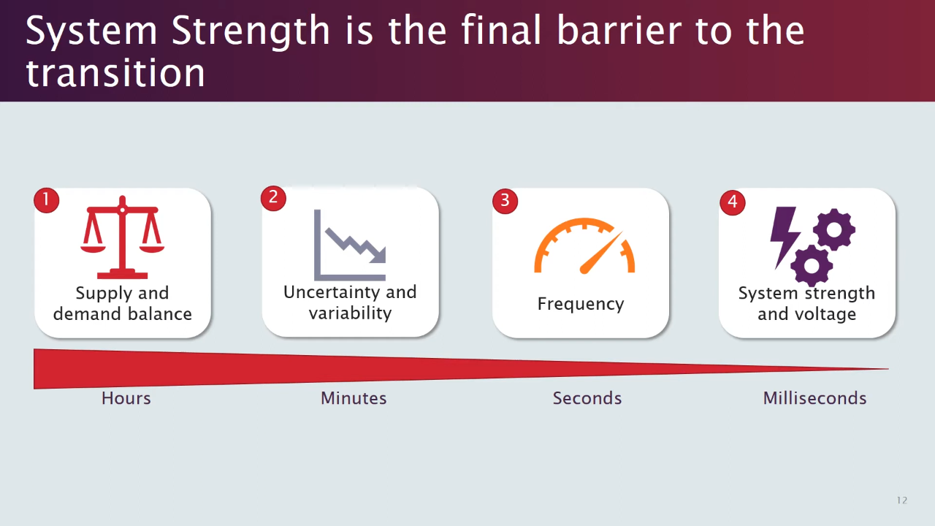
System Strength - Motivation
[session01]

Slide 16
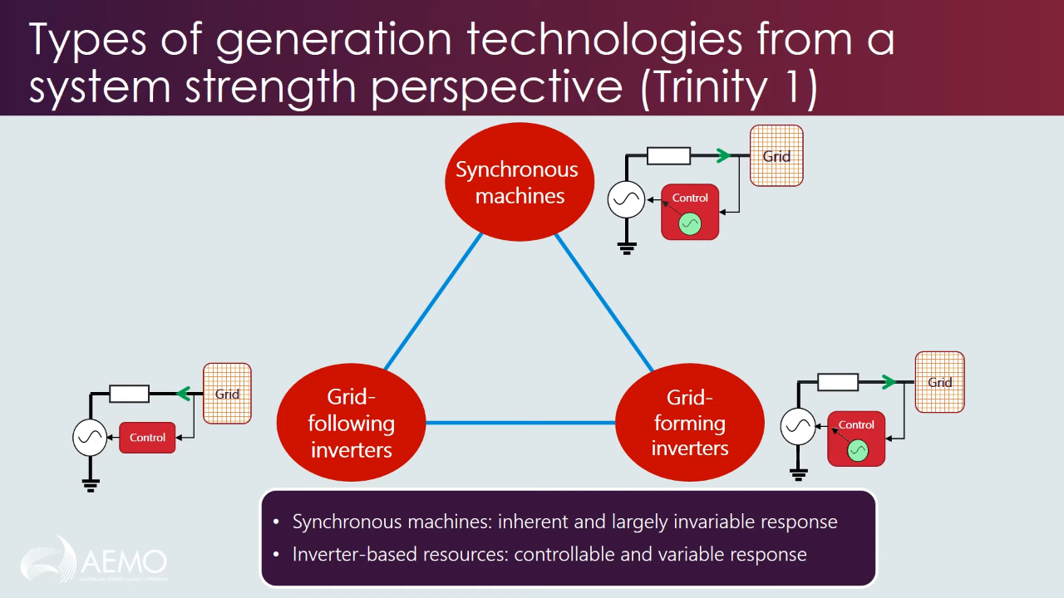
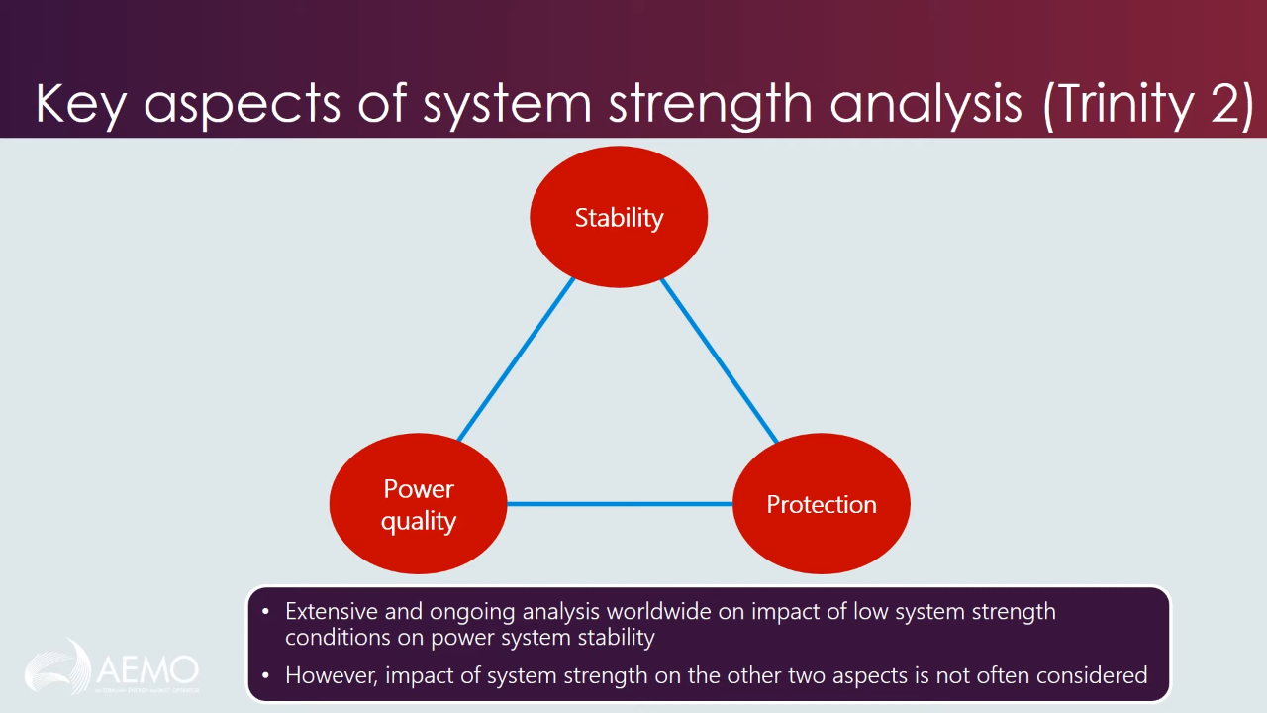
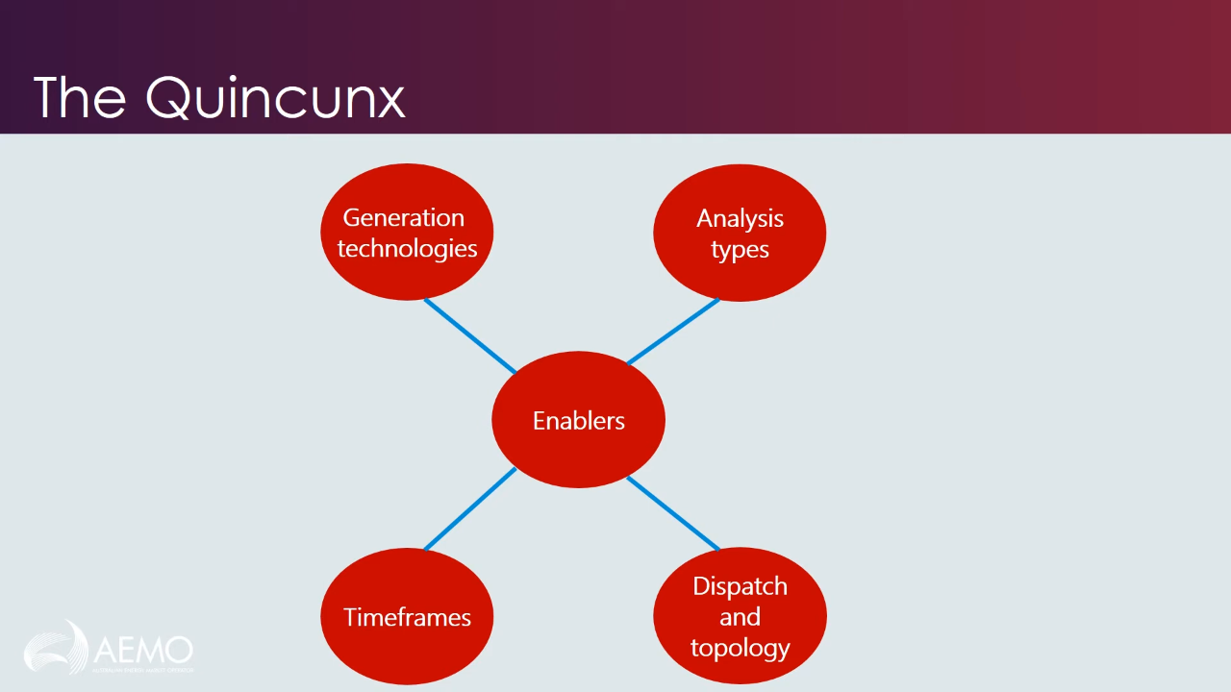
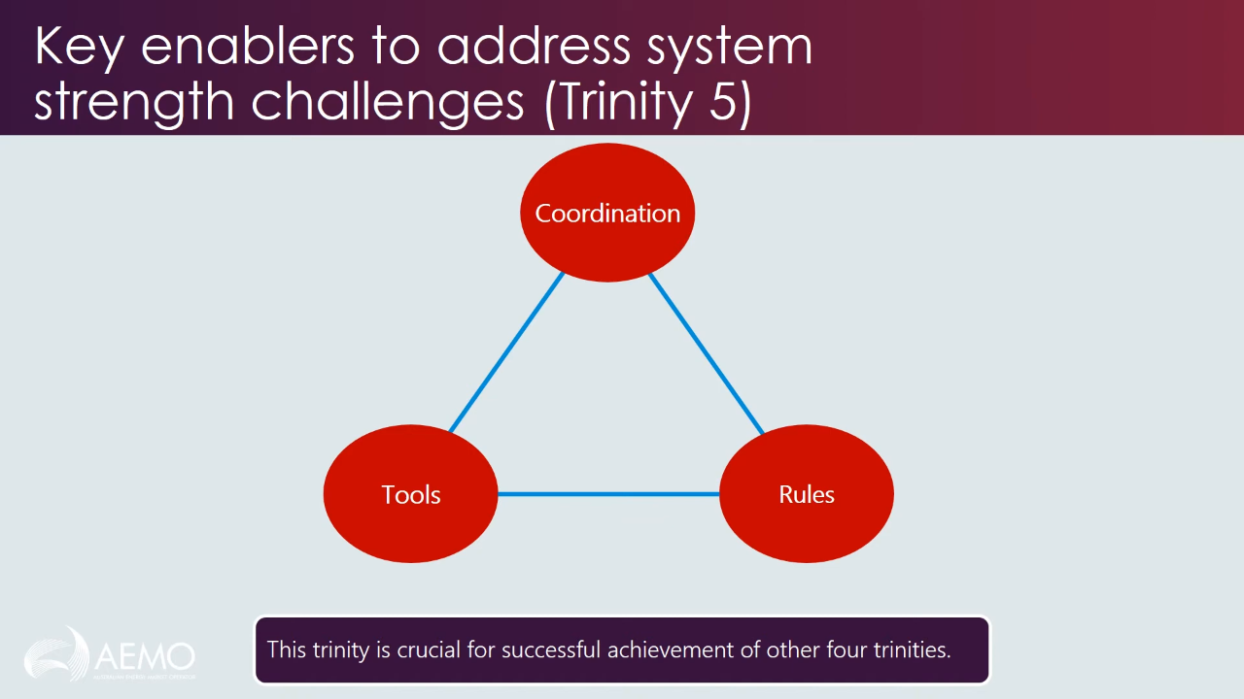
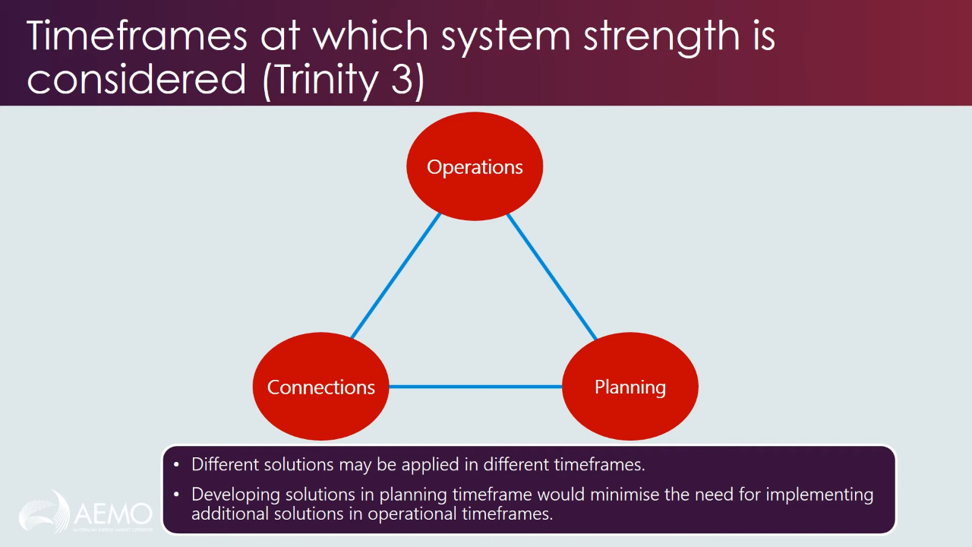
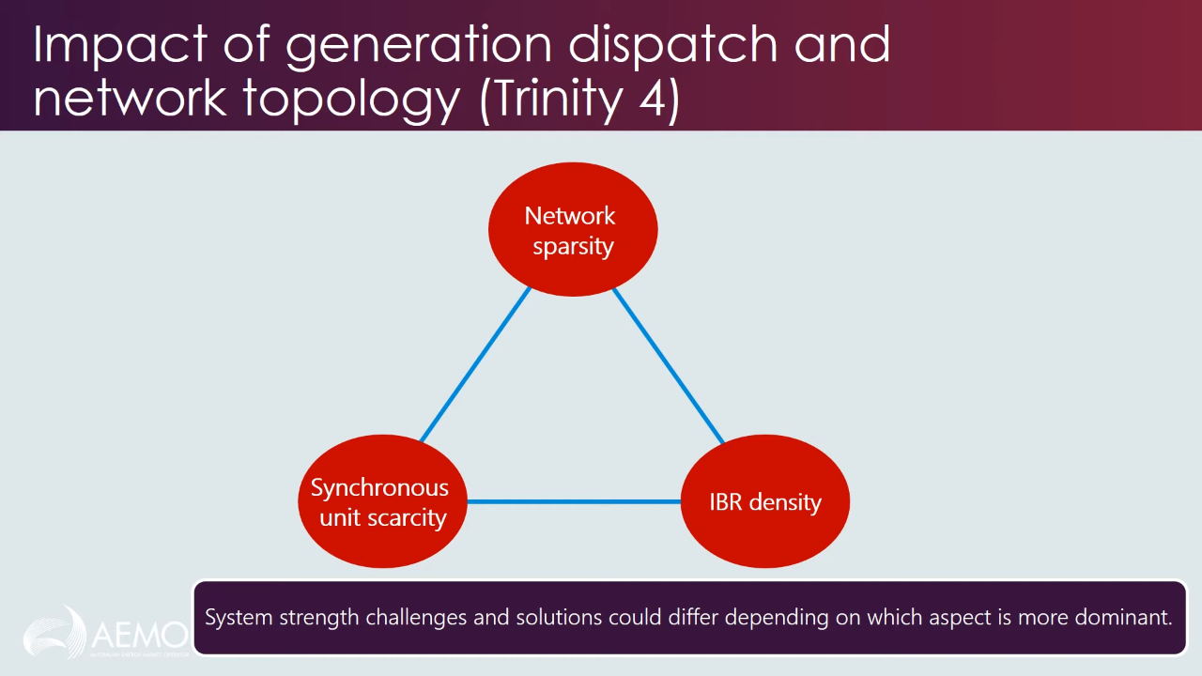
System Strength - Classification
Babak Badrzadeh from AEMO has classified System Strength into five aspects (a ‘quincunx’ : set of five).
Each aspect itself is a trinity of approaches.
[session01]

Slide 17
System Strength - Classification
Generation Technologies
[session01]

Slide 18
System Strength - Classification
Analysis Types
[session01]

Slide 19
System Strength - Classification
Timeframes
[session01]

Slide 20
System Strength - Classification
Dispatch and Topology
[session01]

Slide 21
System Strength - Classification
Key Enablers
[session01]

Slide 22
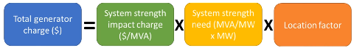
System Strength - Incentivization
Proposed Market Incentivization for Injecting System Strength into the grid for GOs
[session01]

Slide 23
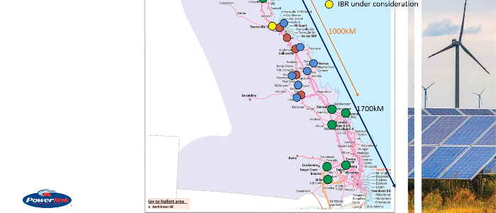
Industry Example 1: GO’s ‘Do No Harm’ responsibility, PIA, FIA
Queensland (QLD) Power Grid
[session02]

Slide 24
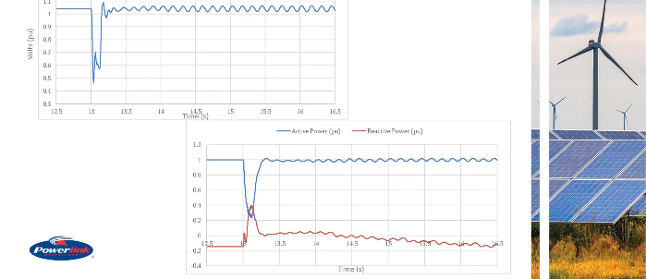
Industry Example 1: GO’s ‘Do No Harm’ responsibility, PIA, FIA
Fault simulated somewhere else in the grid, and its impact on the PoI of the proposed IBR seen.
V @ PoI without SS Adverse Impact Mitigation
P, Q @ PoI without SS Adverse Impact Mitigation
[session02]

Slide 25
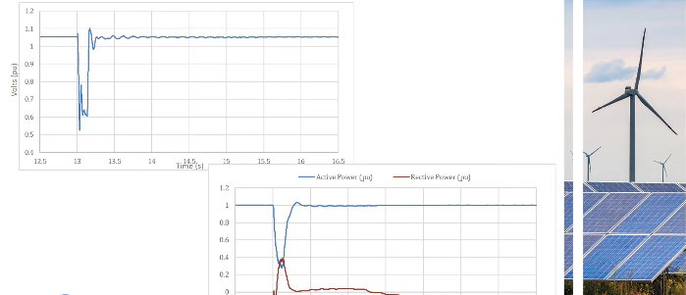
Industry Example 1: GO’s ‘Do No Harm’ responsibility, PIA, FIA
Fault simulated somewhere else in the grid, and its impact on the PoI of the proposed IBR seen.
V @ PoI with SS Adverse Impact Mitigation
P, Q @ PoI with SS Adverse Impact Mitigation
[session02]

Slide 26
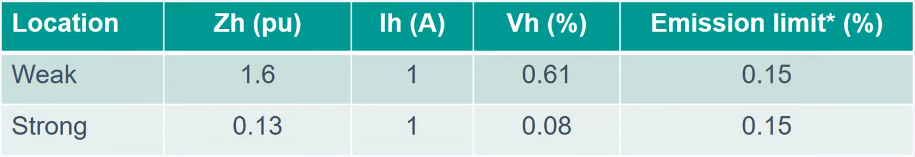
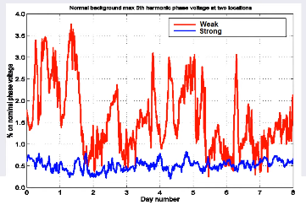
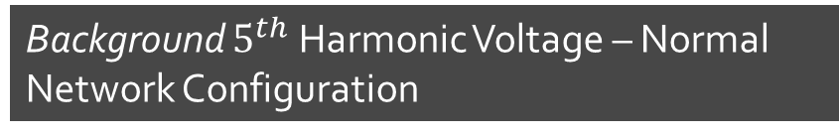
Industry Example 2: Harmonic Distortion due to Shunt Reactive Plant Switching
Weakness of SS causes high 5th harmonic distortion in Voltage
Background $5^{th}$ Harmonic Voltage – Normal Network Configuration
Weaker grids have higher harmonic impedance, which amplify even smaller harmonic currents as a bigger harmonic voltage.
Higher Harmonics not due to any forced oscillation at the PoI, but due to background natural harmonics in the network
Fluctuation in Harmonic Voltage due to various switching in and out of shunt reactive plants
[session02]

Slide 27
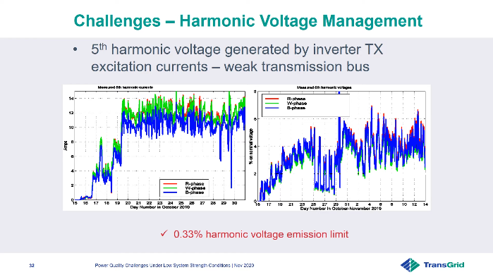
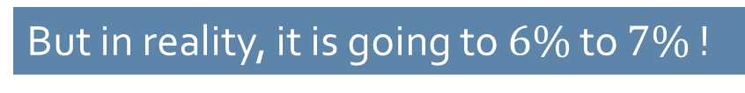
Industry Example 2 : Harmonic Distortion due to Inverter Transformer Excitation Current
Weakness of SS causes high 5th harmonic distortion in Voltage
Harmonic Voltage Emission Limit in $5^{th}$ Harmonic of Bus Voltage is set at $0.33$%
But in reality, it is going to $6\%$ to $7\%$ !
[session02]

Slide 28
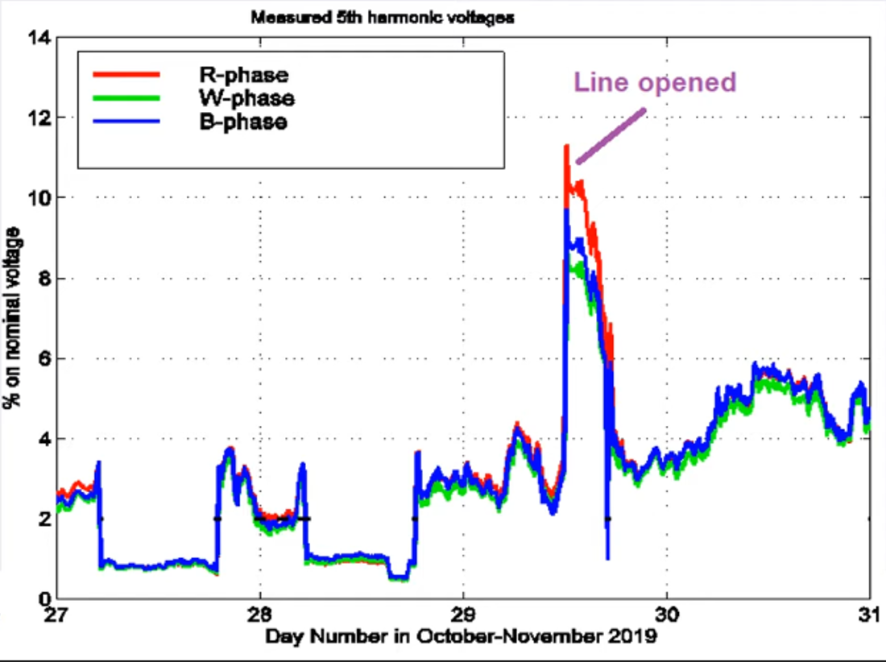
Industry Example 2 : Harmonic Distortion due to Weakened Topology
Harmonic Voltage at a weak bus shoots up when one of the connected lines is opened (network topology slightly weakened)
[session02]

Slide 29
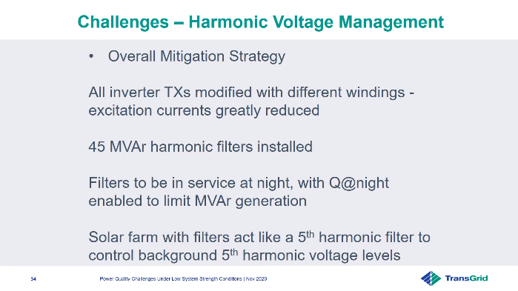

Industry Example 2: How to counter these Power Quality ($5^{th}$ Harmonic) Issues?
[session02]

Slide 30
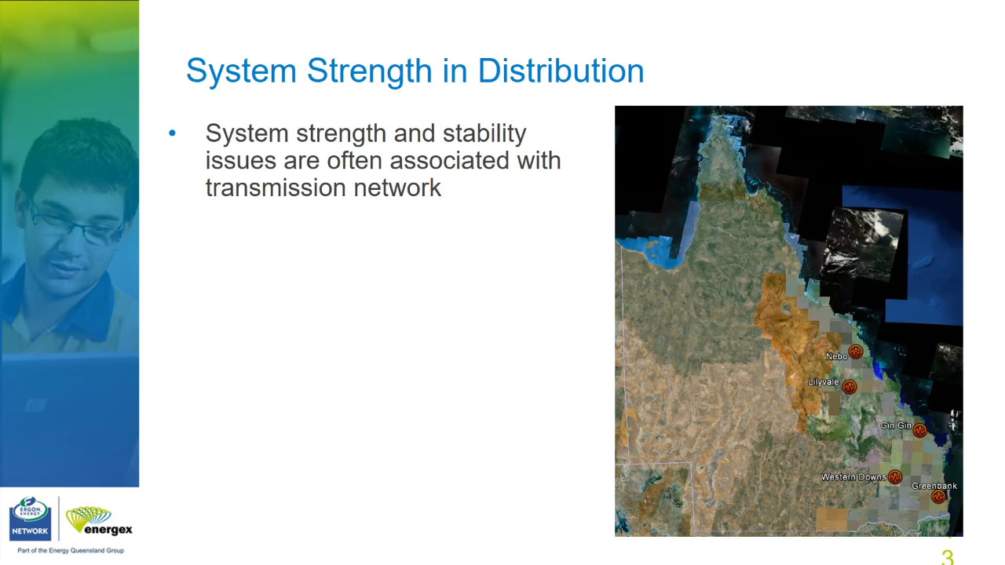
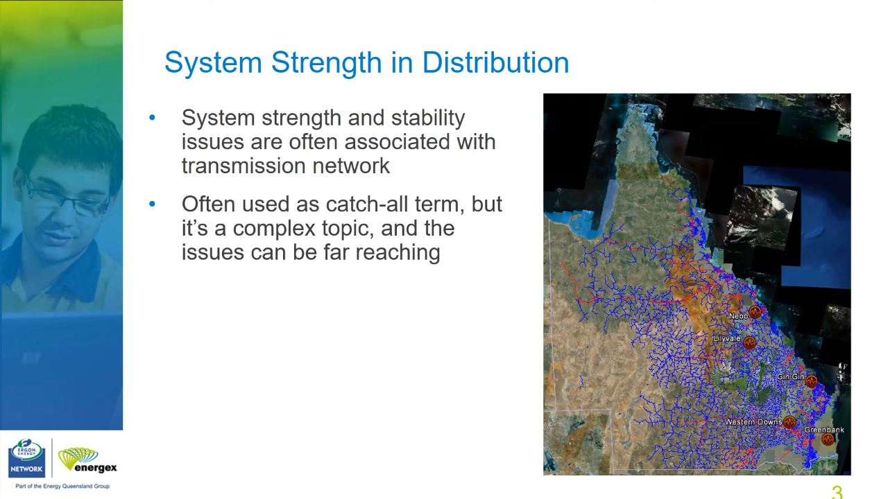
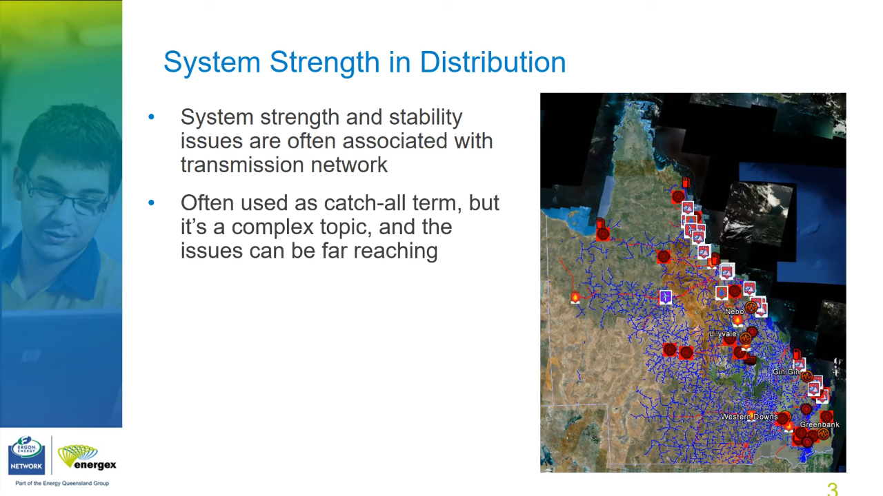
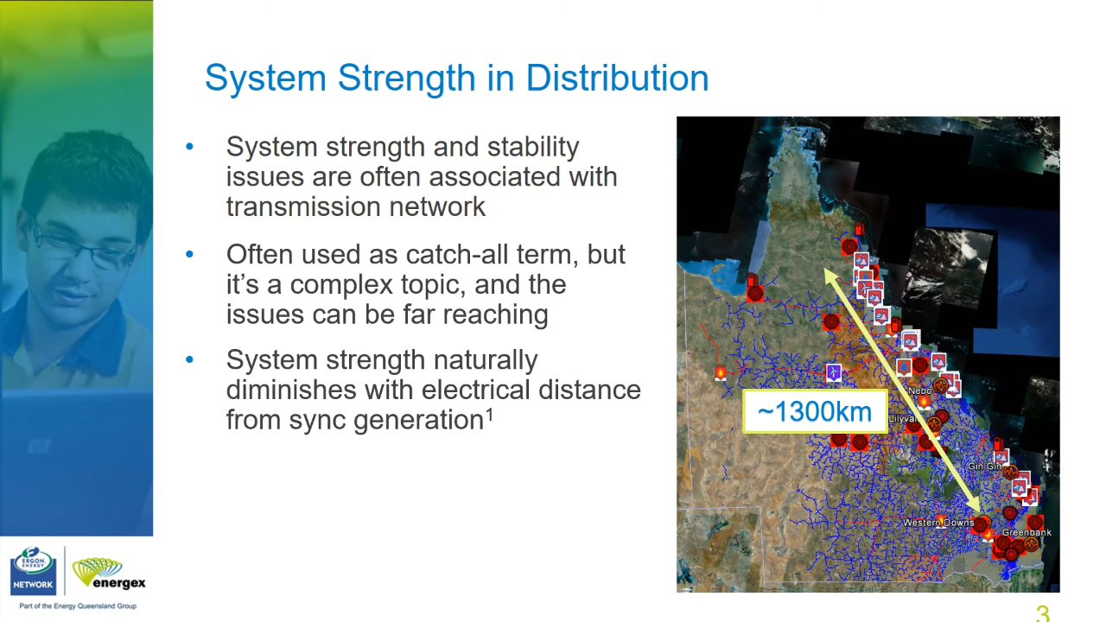
Industry Example 4
Queensland (QLD) Power Grid
A: SGs along the coast
B: A + Sub-tlines (red) and Dist lines (blue)
C: B + Renewables
C: Distance between SGs and Renewables
[session02]
System Strength naturally diminishes with electrical distance from SGs [ARENA2020]

Slide 31
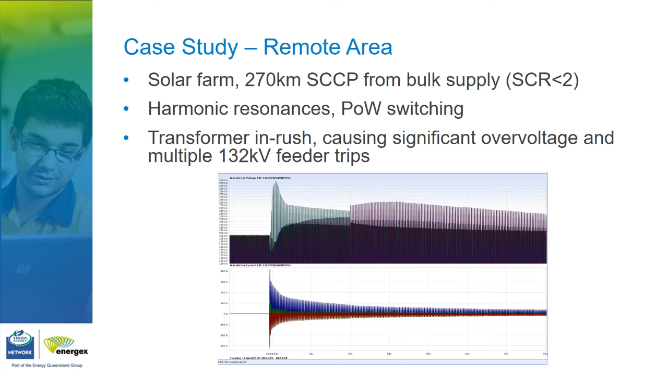
Industry Simulation Example 3
Later
[session02]

Slide 32
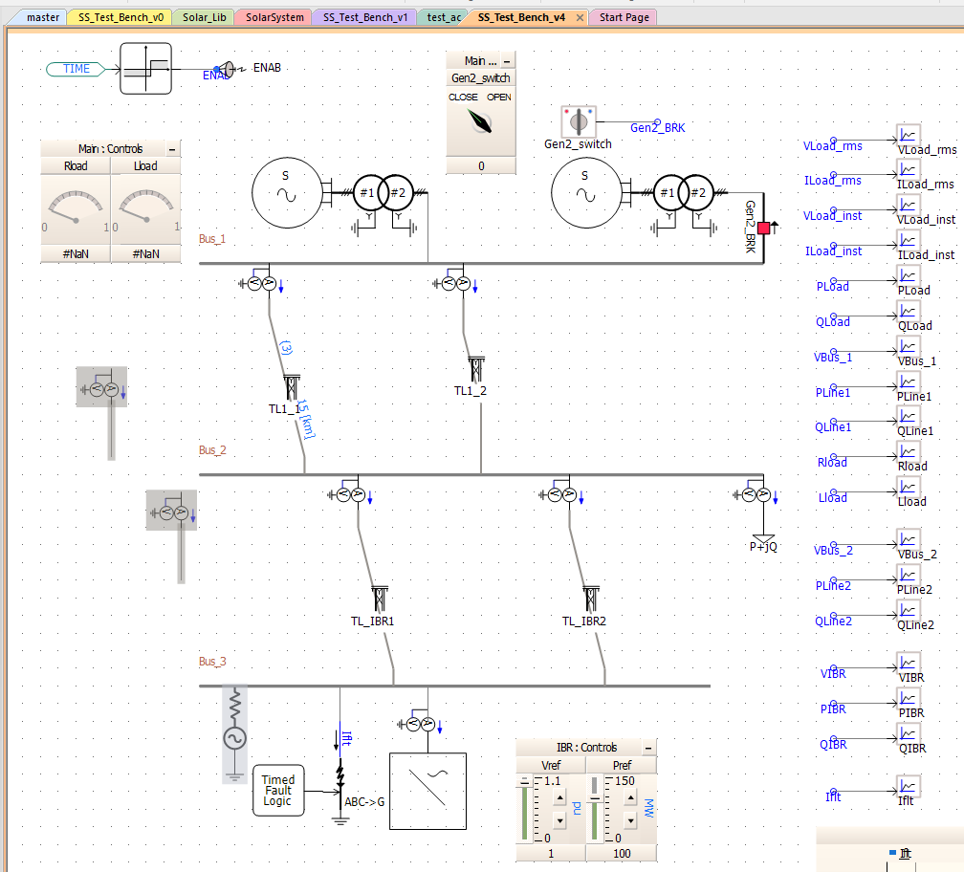
In Process: Building a Demo to demonstrate Symptoms of Weak System Strength in PSCAD

Slide 33
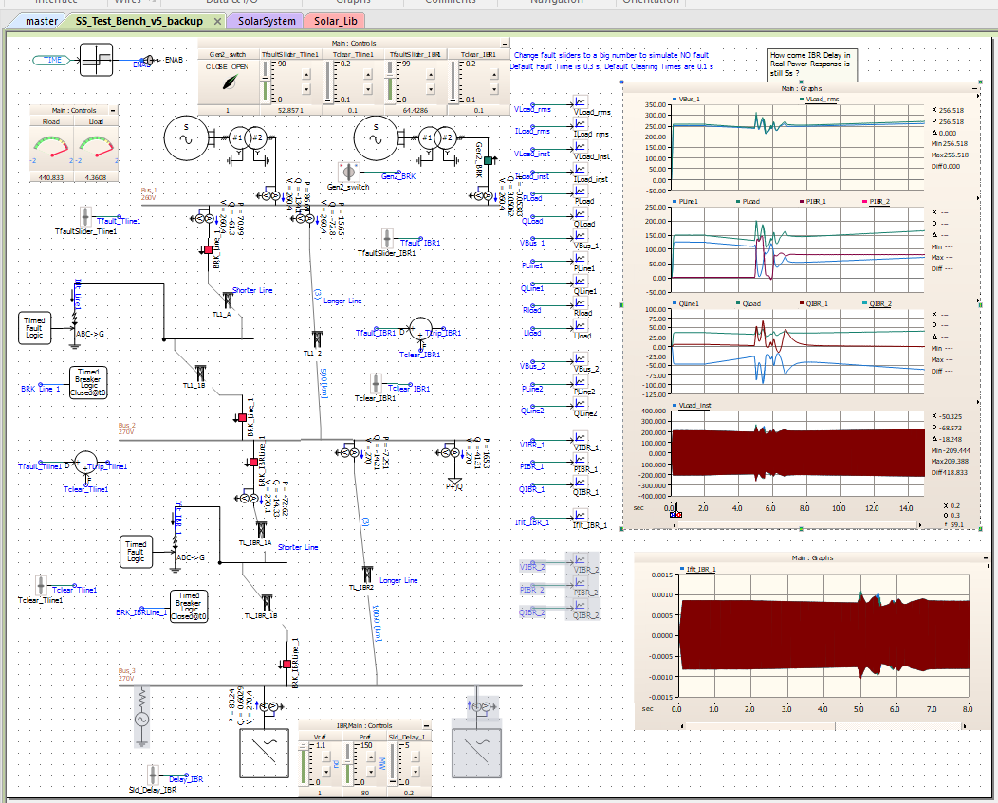
In Process: Building a Demo to demonstrate Symptoms of Weak System Strength in PSCAD

Slide 34
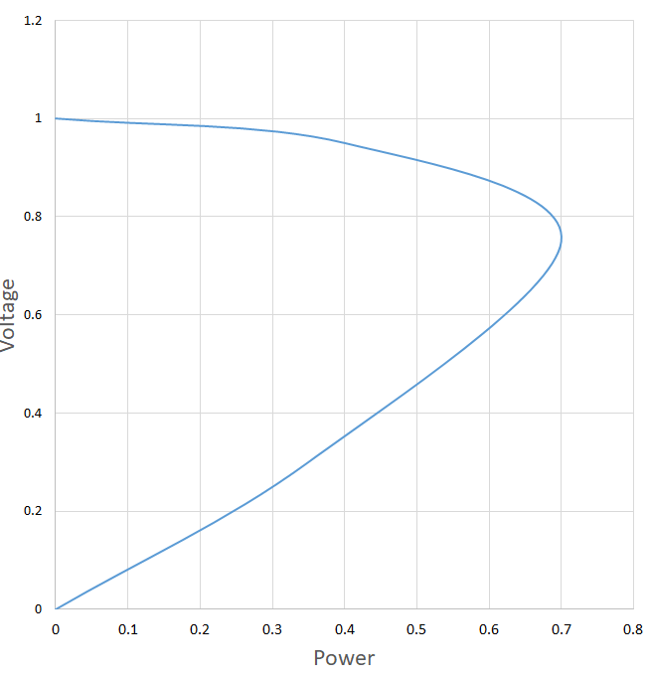
PV Curve
wrt changing balance point of real power at the node
Normally PV Continuation curves [PVCurve] are studied for load buses to study effect of nodal voltage due to load demand (Real) power.

Slide 35
References
[ARENA2020] Managing System Strength During the Transition to Renewables. (2020, August 03). Retrieved from https://arena.gov.au/knowledge-bank/managing-system-strength-during-the-transition-to-renewables
[cigre-SS-YT-20] CIGRE Australia. (2024, June 21). AEMO/CIGRE System Strength Workshop Nov 2020. Youtube. Retrieved from https://www.youtube.com/playlist?list=PLwGHigN9C41BaJhk_rfXeoT8e67-m4aDX
[cigre-SS-Workshop-Iti]
[AEMO-SSIAG] AEMO | System Strength Impact Assessment Guidelines
[AEMO-SS-Explained] System Strength Explained (aemo.com.au)
[AEMO-SS-FAQ] System Strength Framework Frequently Asked Questions (aemo.com.au)
[AEMO-Calculating-SS] Calculating system strength quantities in the NEM (aemo.com.au)
[cigre-SS-Brief-2021] Chair, B. B. (.- C4. 5. C. a. Z. E. (.- S. C. (2021). System Strength. CIGRE. Retrieved from https://www.cigre.org/article/GB/publications/reference-papers/system-strength

Slide 36
References
[odessa22] RSTC_Reliability_Guidelines - All Documents. (2024, June 21). Retrieved from https://www.nerc.com/comm/RSTC_Reliability_Guidelines/Forms/AllItems.aspx
[PVCurve] Contributors to Wikimedia projects. (2023, December 16). Power-voltage curve - Wikipedia. Retrieved from https://en.wikipedia.org/w/index.php?title=Power-voltage_curve&oldid=1190109767
[Quays2023] Qays, M. O., Ahmad, I., Habibi, D., Aziz, A., & Mahmoud, T. (2023). System strength shortfall challenges for renewable energy-based power systems: A review. Renewable Sustainable Energy Rev., 183, 113447. doi: 10.1016/j.rser.2023.113447
[southtexas24] South Texas Wind Events_03082024.pptx. (2024, June 21). Retrieved from https://view.officeapps.live.com/op/view.aspx?src=https%3A%2F%2Fwww.ercot.com%2Ffiles%2Fdocs%2F2024%2F03%2F06%2FSouth%2520Texas%2520Wind%2520Events_03082024.pptx&wdOrigin=BROWSELINK

